Slide 1
EVERGREEN MARKETING KIT

Slide 2
MARKETING KIT GUIDELINES
Leverage the assets within this marketing kit to delight and inspire MRS. SMITH’S® shoppers along the path to purchase.
Leverage retailer channels: placements in communications and tactics pre-shop (digital and circular).
Leverage marketing kit assets to have a consistent look and feel at all touch points during the campaign.
CIRCULAR ASSETS
Assets will include editable files along with MRS. SMITH’S® pack-shot images.
Leverage assets for placement in-ad and can update with correct product mix, description and pricing.
DIGITAL BANNERS
Assets will include editable files. Retailers can add their logo to the banner.
Leverage assets for placement on retail websites or ad exchange and can update the CTA based on click-through destination.
Click-through: all banner ads should link to MRS. SMITH’S® product information on the brand’s site, retailer’s site or digital incentives (if available).
SOCIAL MEDIA
Assets will include digital-ready images that can be used on retailer’s Facebook, X and Instagram channels.
Social post copy will be provided. Retailers can adjust copy to align with their social voice/tone and can highlight special offers or deals available on mrssmiths.com or the retailer’s site.
Click-through/link: social posts should link to MRS. SMITH’S® product information on brand’s site, retailer’s site or digital incentives (if available).

Slide 3
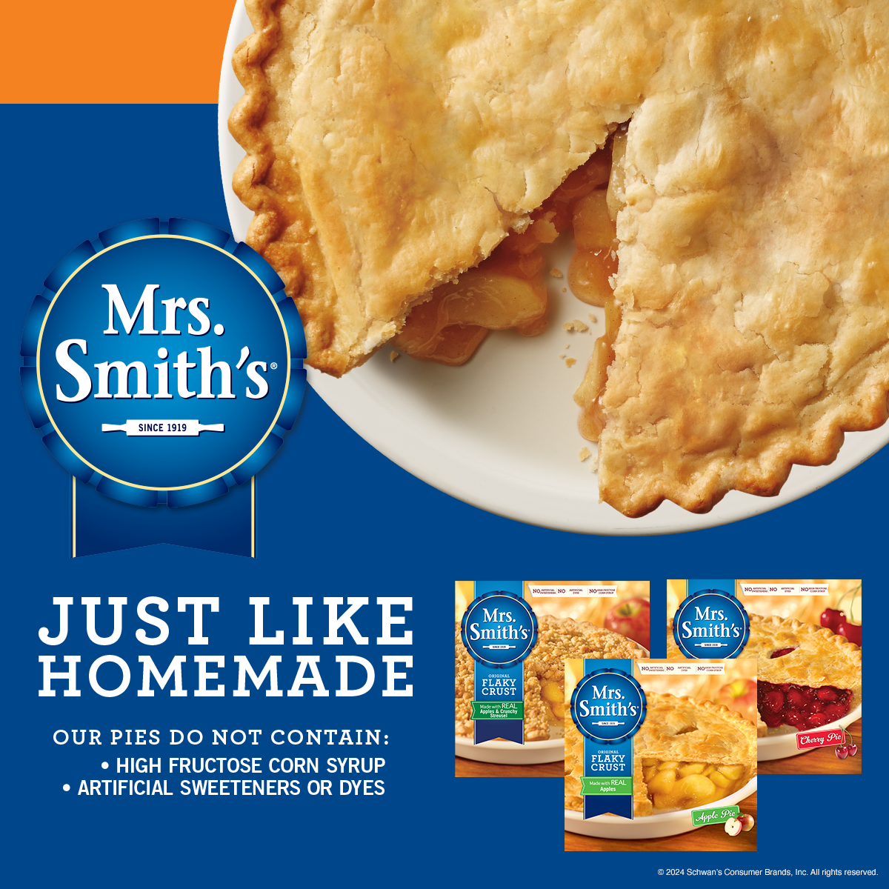
EVERGREEN MARKETING KIT DELIVERABLES
DELIVERABLES
Circular Ad Layouts
3" W x 3" H and 10" W x 3" H
Digital
Standard banners:
300 x 250, 728 x 90, 160 x 600 and 320 x 50
Social Media
Instagram: 1080 x 1350 pixels
Facebook: 1200 x 1200 pixels
X: 1200 x 1200 pixels
+ post copy options for all platforms
DOWNLOAD ASSETS:
CLICK HERE
HAVE QUESTIONS OR NEED ADDITIONAL SUPPORT?
Contact: Zachary Berg zachary.berg@schwans.com

Slide 4
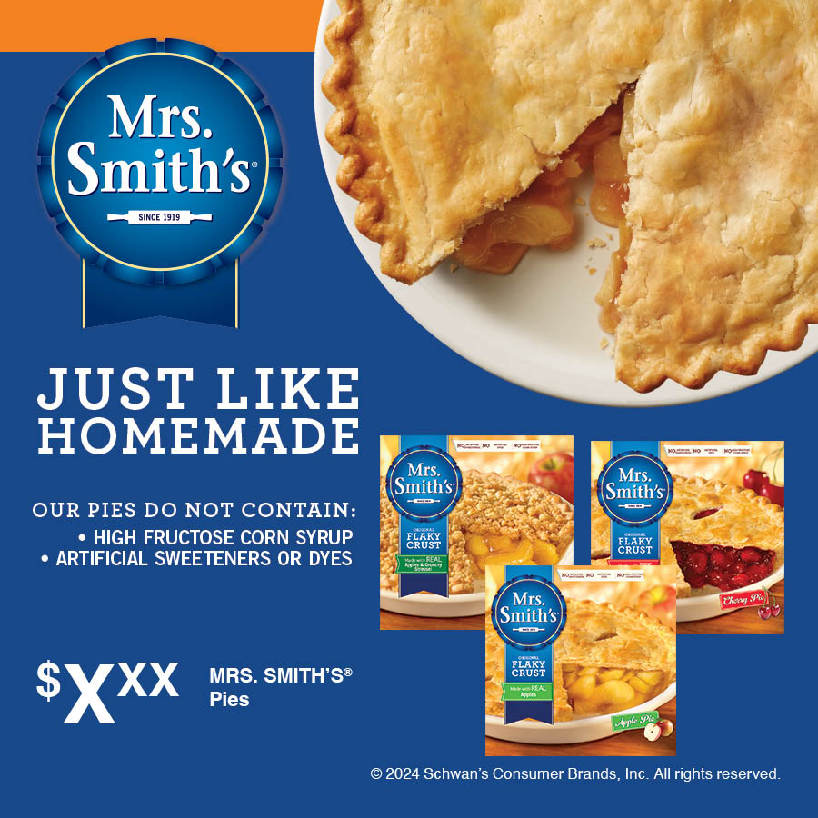
CIRCULAR ADS
Circular Ad Layouts
3" W x 3" H and 10" W x 3" H
3" W X 3" H
10" W X 3" H

Slide 5
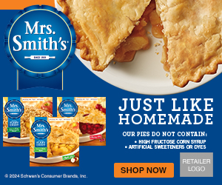
DIGITAL BANNERS
Digital Standard Banners
300 x 250 728 x 90 160 x 600 320 x 50
Alt CTAs:
PLEASE NOTE: layered photoshop files for each size contain CTA (shop now, save now and learn more) that can be swapped out.
300 x 250
320 x 50
728 x 90
160 x 600

Slide 6
DIGITAL CTA OPTIONS
Learn More, Shop Now or Save Now CTA Options:
Link to the product page on the retailer's website for product information (CTA: Learn More).
Link to the product page on the retailer's website to add to cart if they have this capability (CTA: Shop Now).
Link to a coupon or offer (CTA: Save Now).
300 x 250 SHOP NOW
300 x 250 SAVE NOW
300 x 250 LEARN MORE

Slide 7
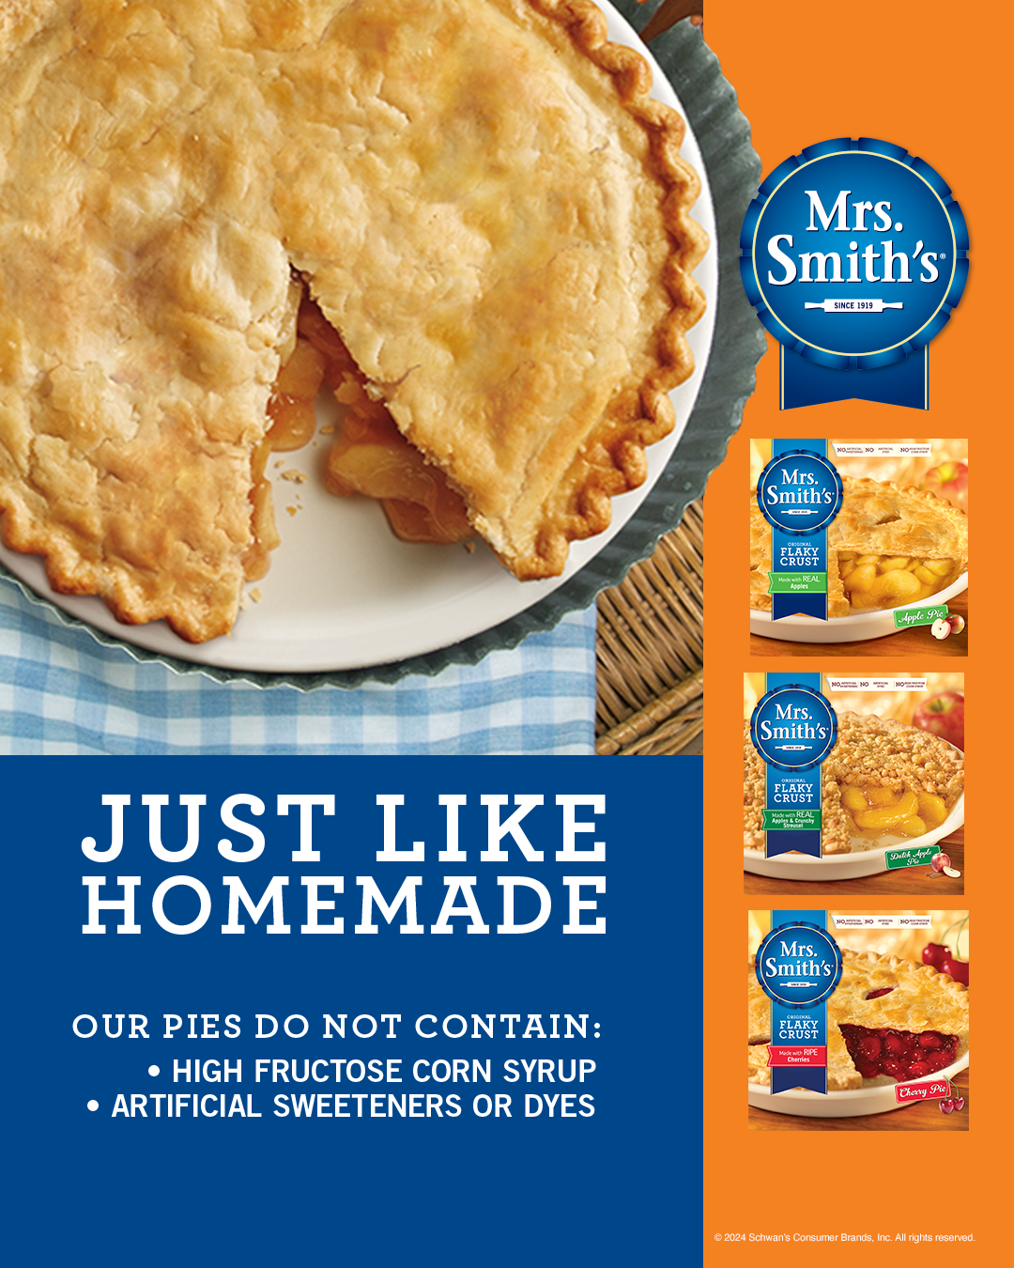
SOCIAL MEDIA
Instagram: 1080 x 1350 Facebook: 1200 x 1200 X: 1200 x 1200
The best ingredients make for the best get-togethers. That’s where MRS. SMITH’S® Pies come in, with their just-like-homemade tastiness you just can’t pass up.
FACEBOOK & X
INSTAGRAM
MRS. SMITH’S® Pies
Your Description Here
SOCIAL POST COPY OPTIONS
The best ingredients make for the best get-togethers. That’s where MRS. SMITH’S® Pies come in, with their just-like-homemade tastiness you just can’t pass up.
Make family and friends feel welcome one bite at a time with a variety of delicious pies from MRS. SMITH’S®.
With tasty, flakey crusts and a variety of flavorful options including Apple, Cherry and Dutch Apple, MRS. SMITH’S® Pies have exactly what your family is looking for.
FACEBOOK

